Slide 1
Html tags

Slide 2
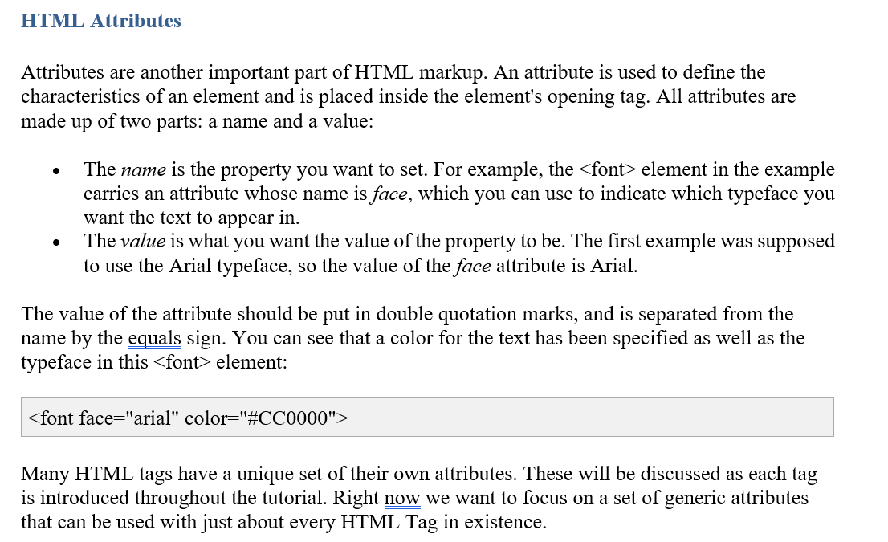

Slide 3
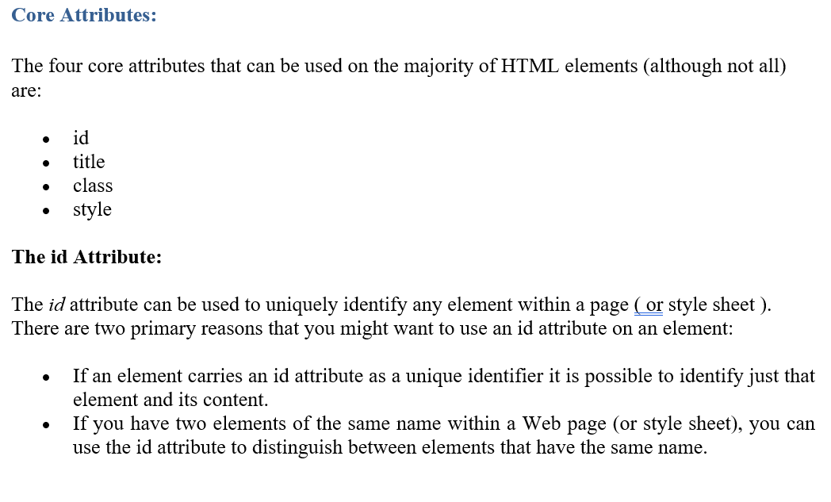

Slide 4
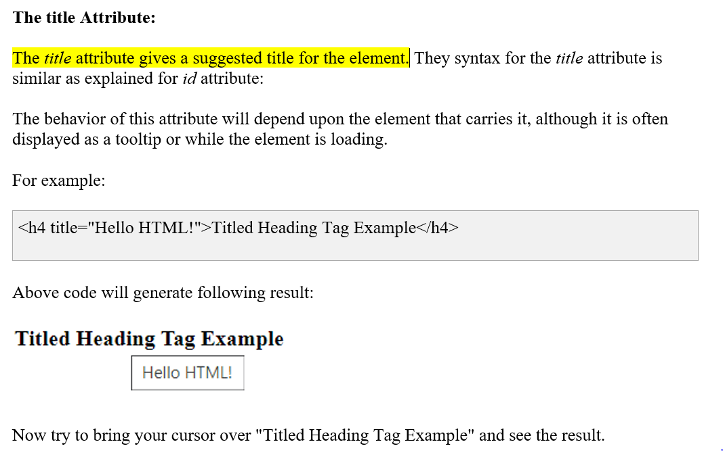

Slide 5
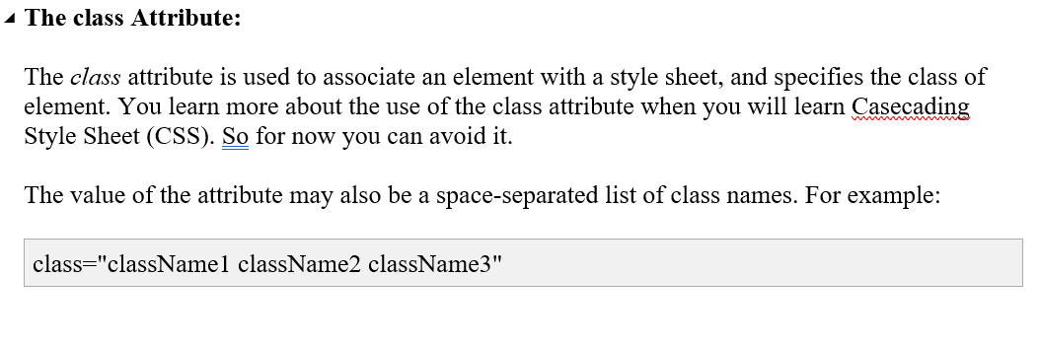

Slide 6
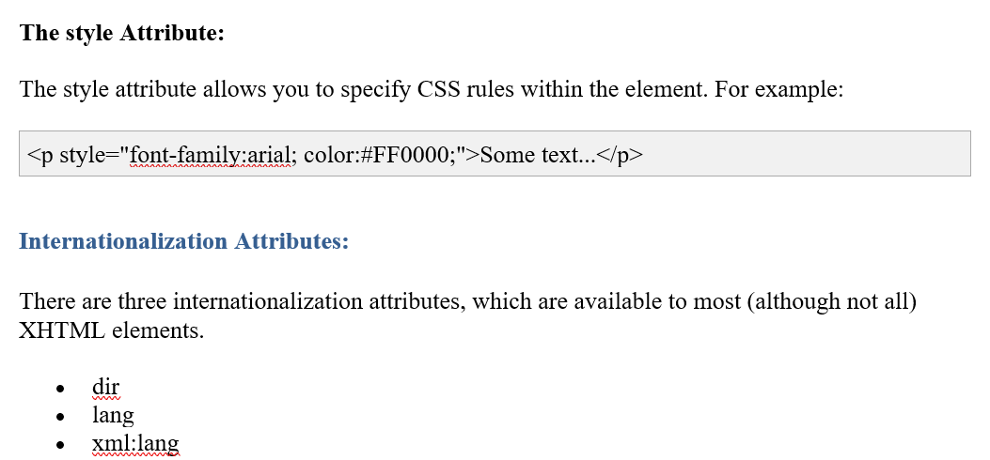

Slide 7
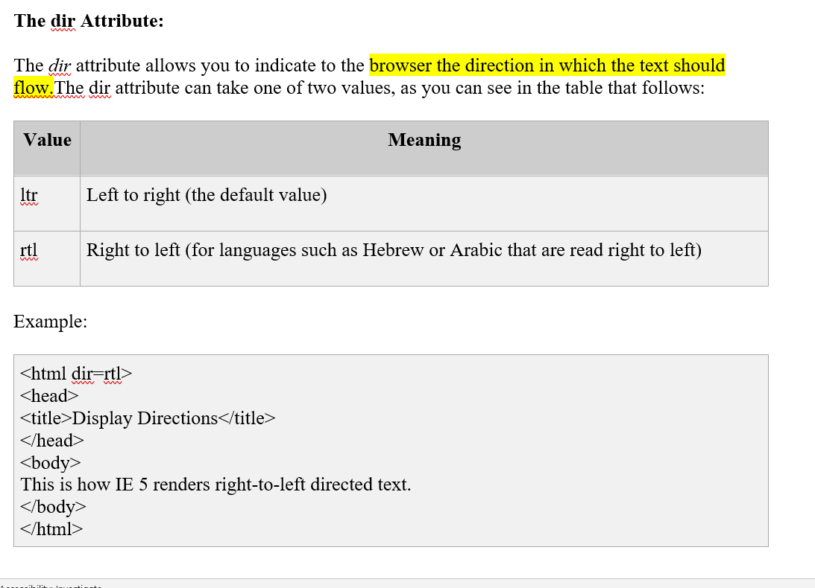

Slide 8
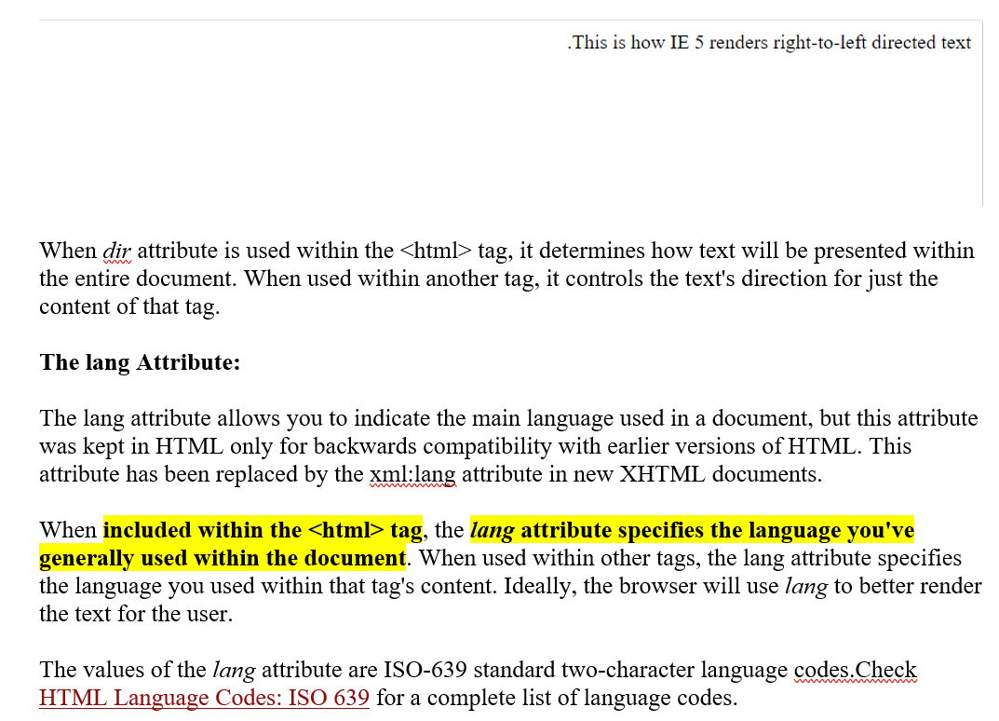

Slide 9
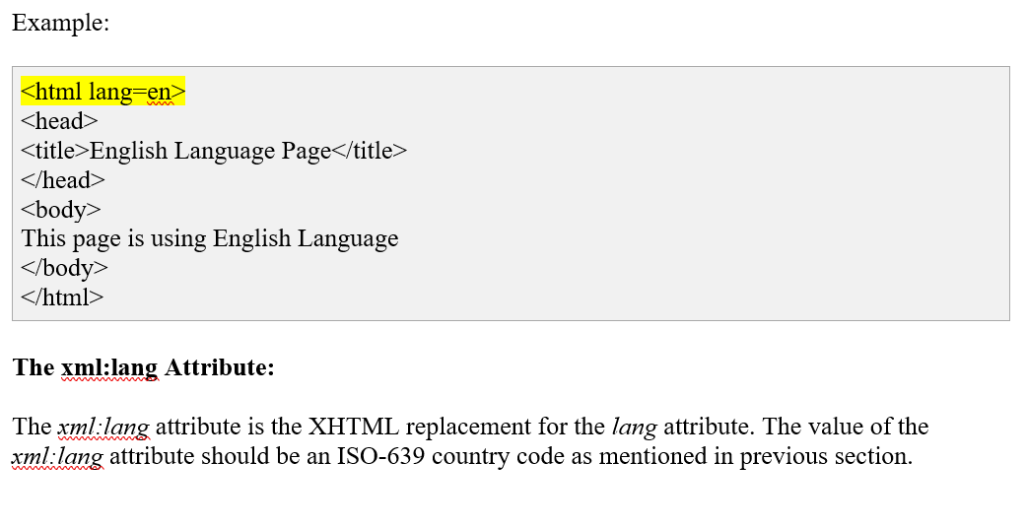

Slide 10
Generic Attributes: Here's a table of some other attributes that are readily usable with many of HTML's tags.
Attribute | Options | Function
align | right, left, center | Horizontally aligns tags
valign | top, middle, bottom | Vertically aligns tags within an HTML element.
bgcolor | numeric, hexidecimal, RGB values | Places a background color behind an element
background | URL | Places an background image behind an element
id | User Defined | Names an element for use with Cascading Style Sheets.
class | User Defined | Classifies an element for use with Cascading Style Sheets.
width | Numeric Value | Specifies the width of tables, images, or table cells.
height | Numeric Value | Specifies the height of tables, images, or table cells.
title | User Defined | "Pop-up" title for your elements.

Slide 11
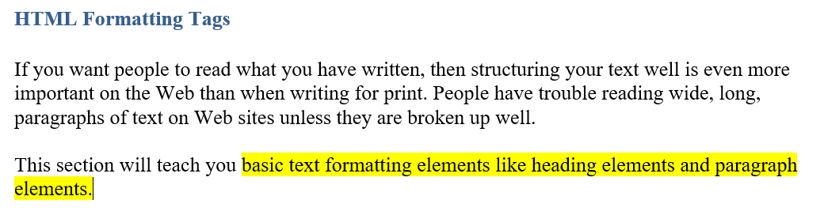

Slide 12
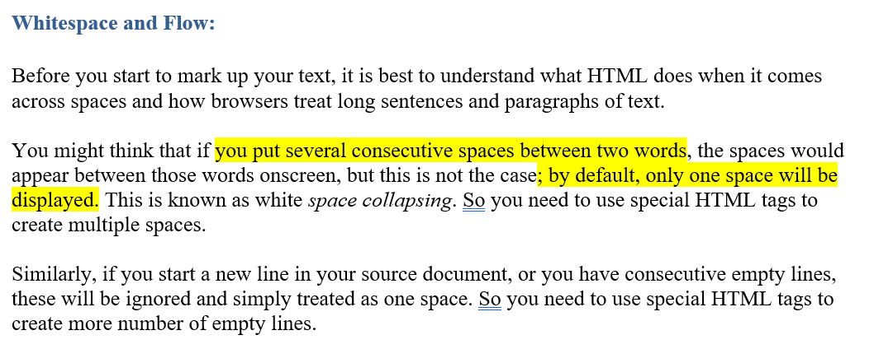

Slide 13
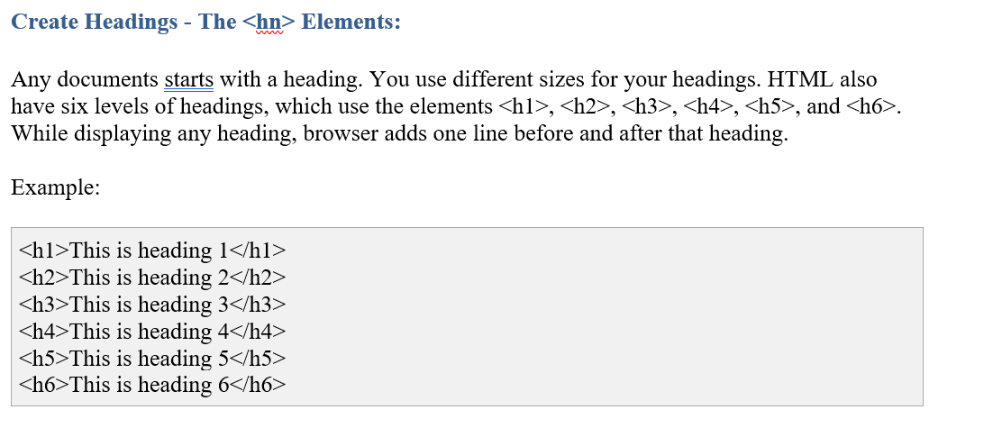

Slide 14
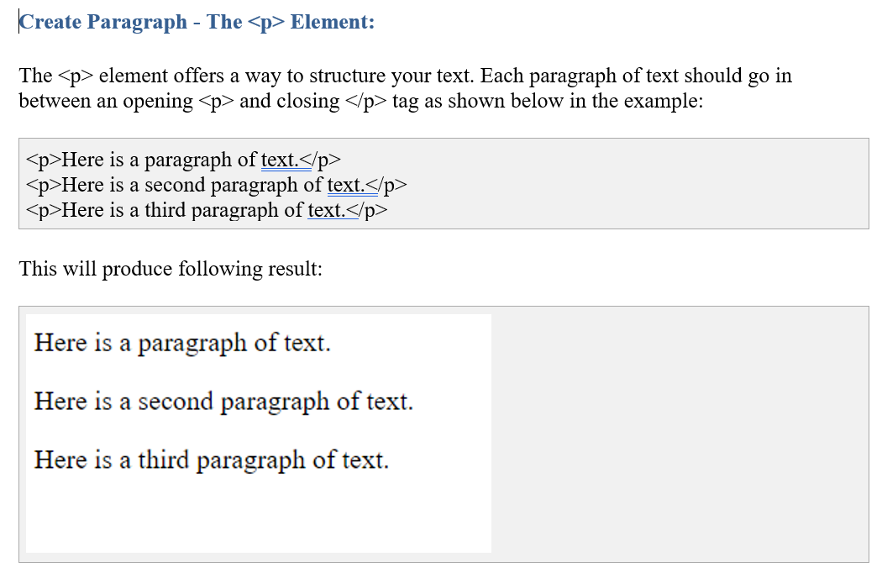

Slide 15
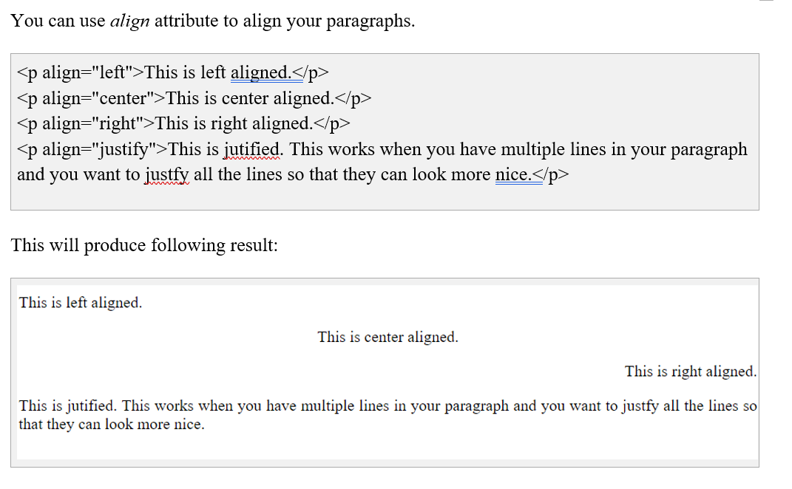

Slide 16
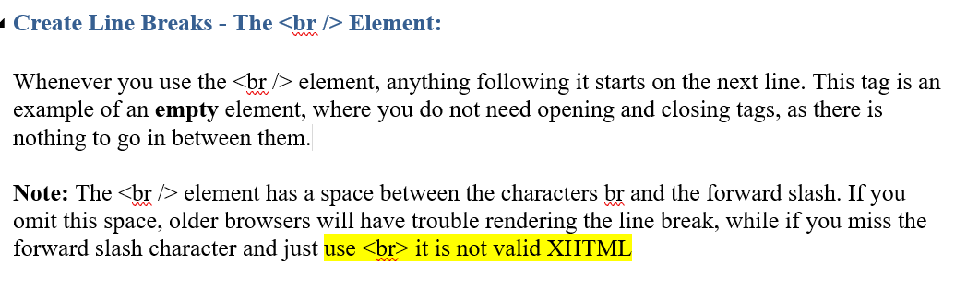
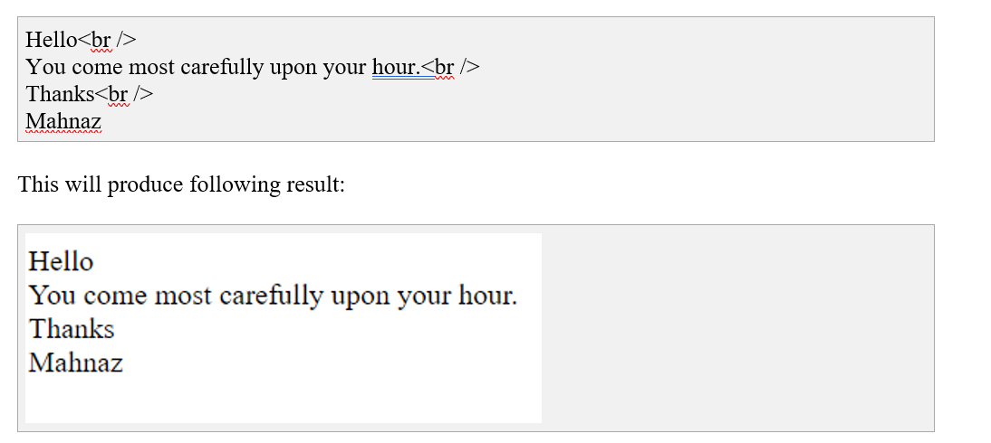

Slide 17
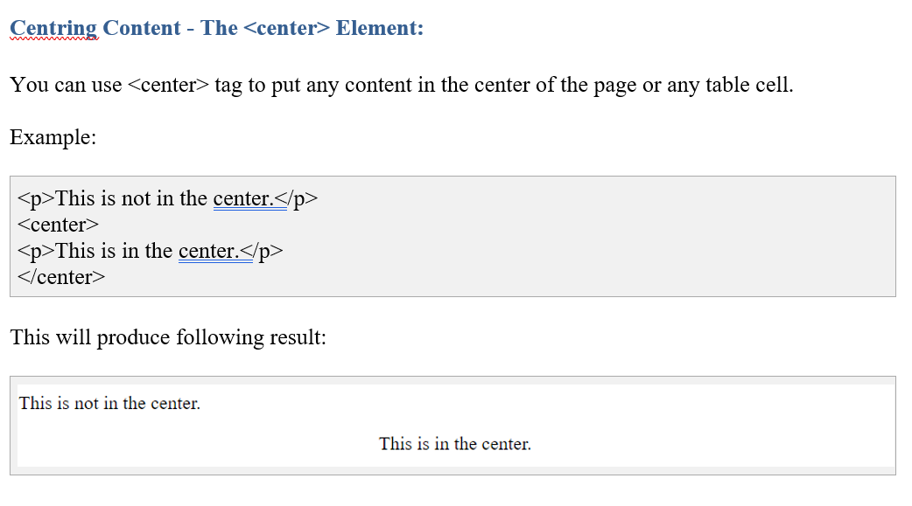

Slide 18
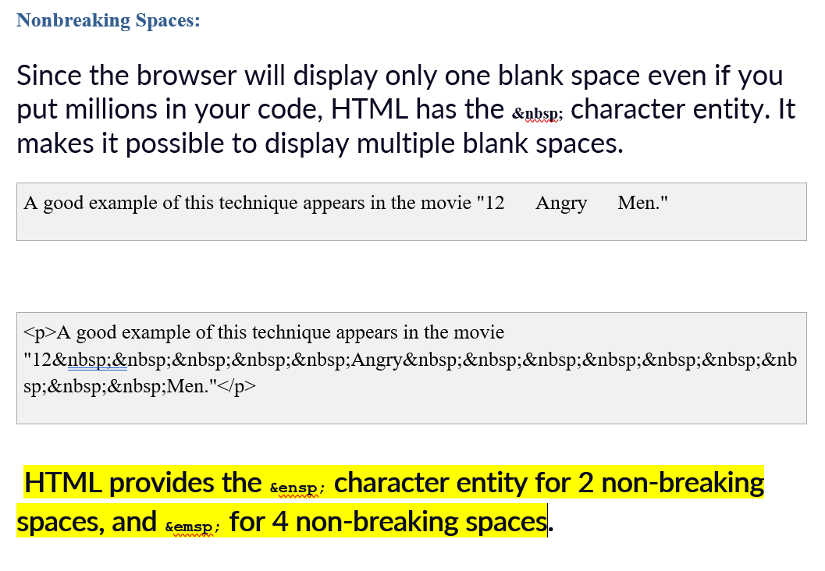

Slide 19
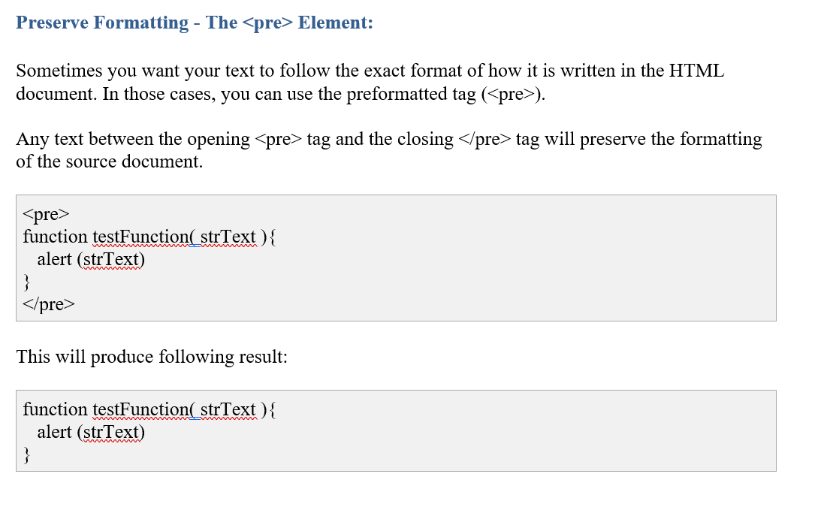

Slide 20
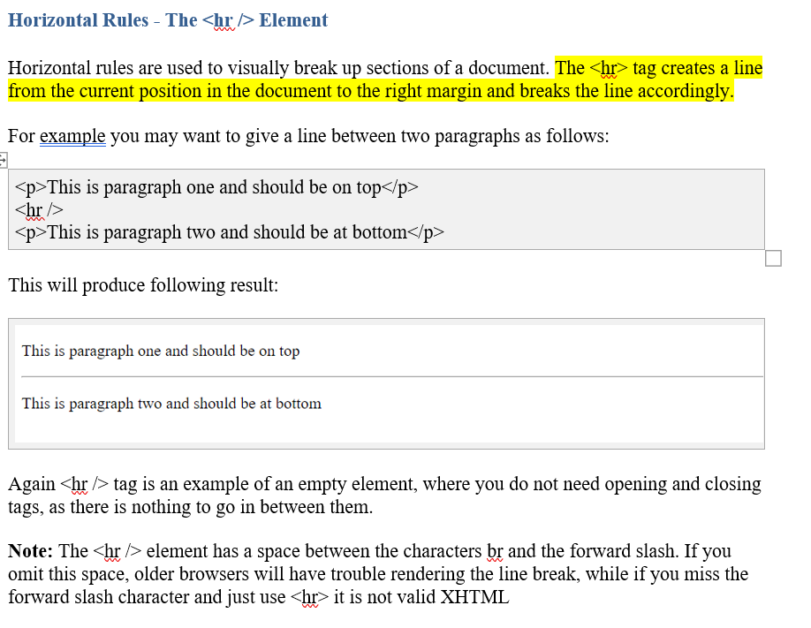

Slide 21
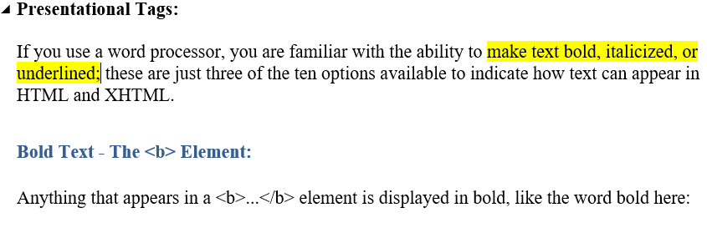
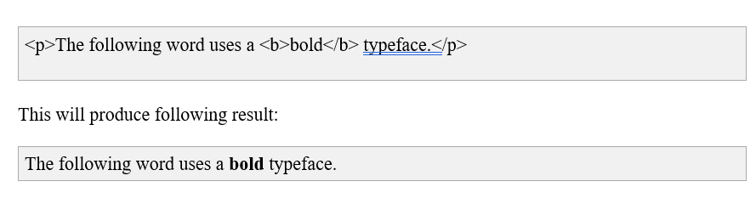

Slide 22
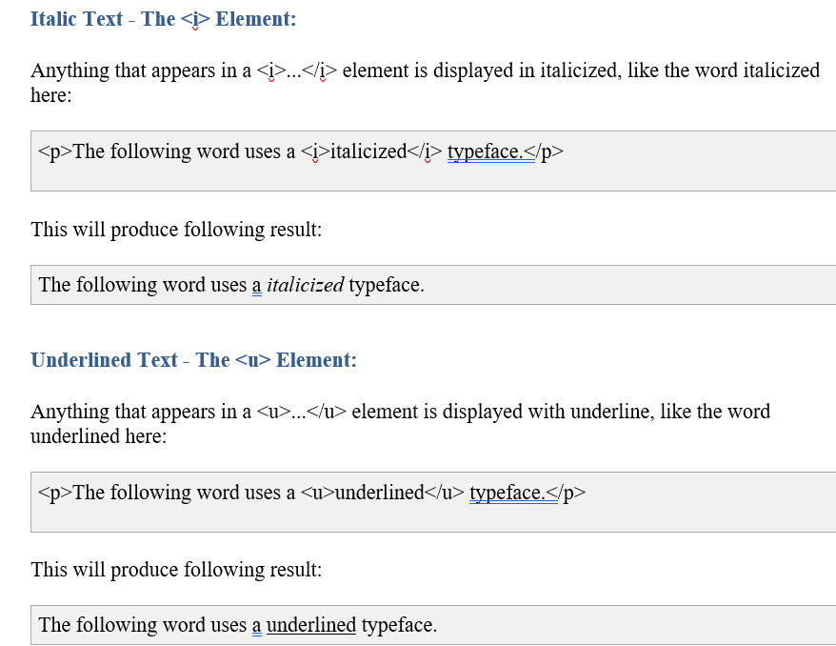

Slide 23
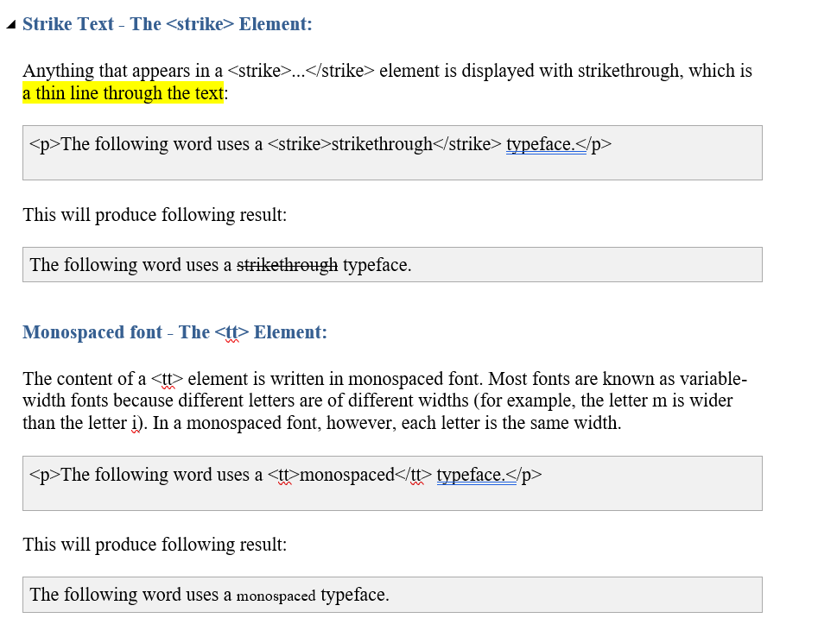

Slide 24
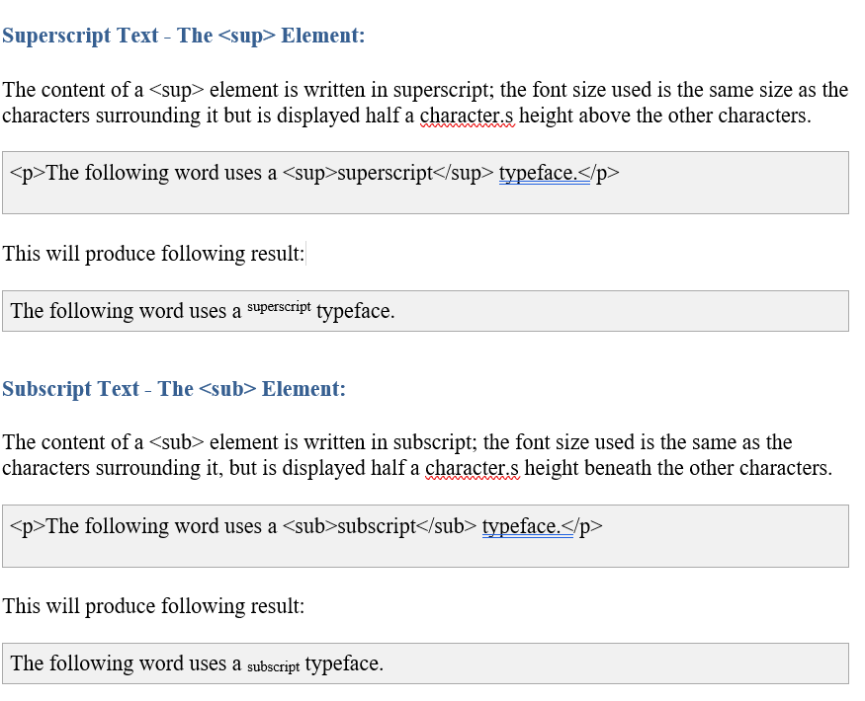

Slide 25
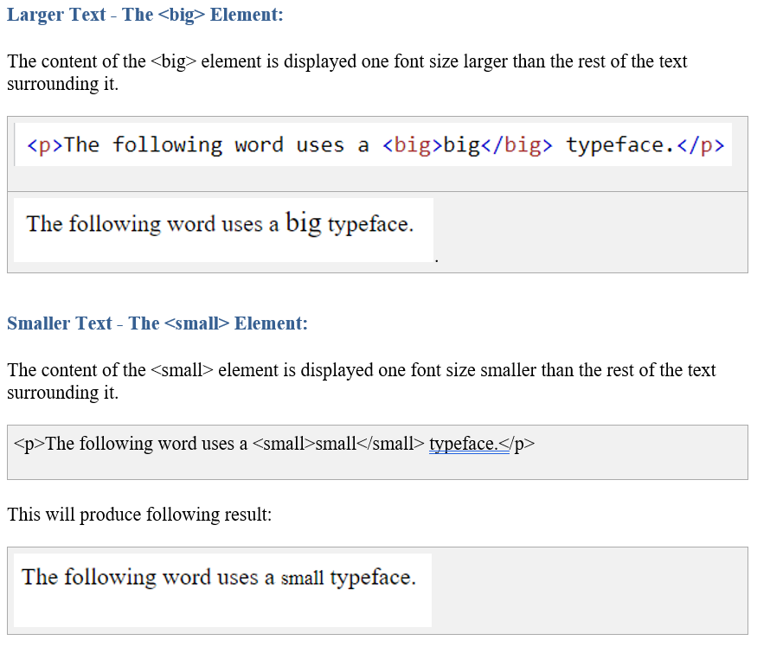

Slide 26
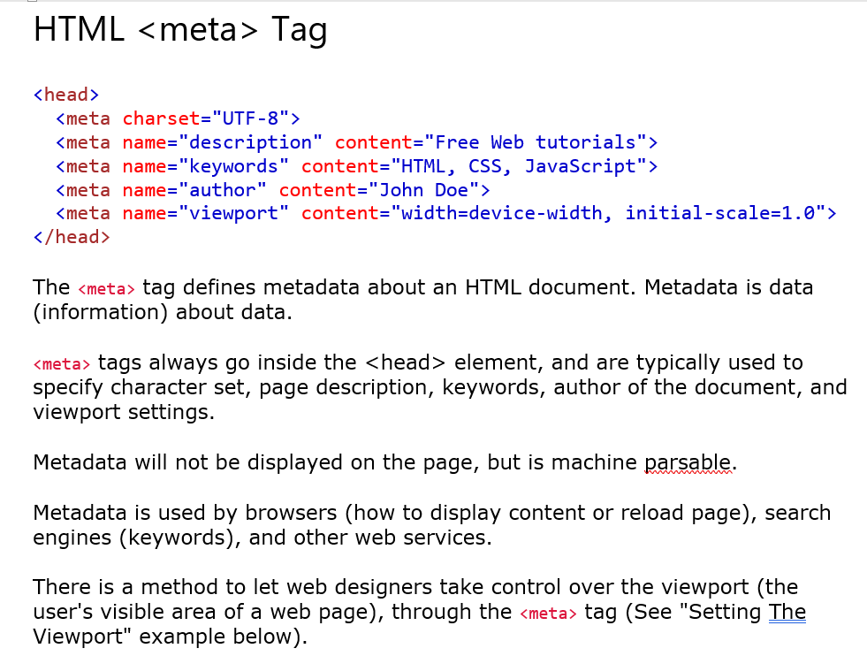

Slide 27
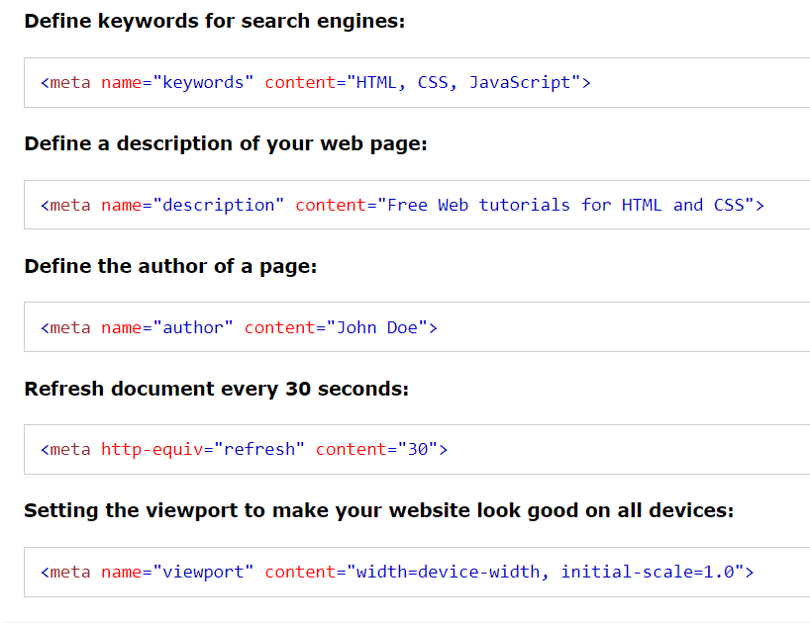

Slide 28
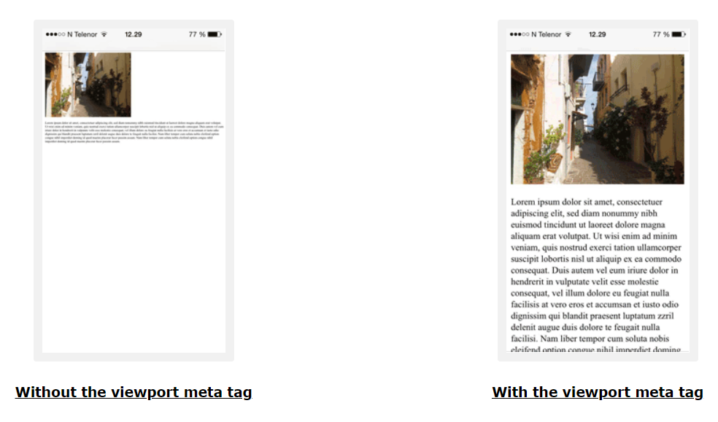

Slide 29
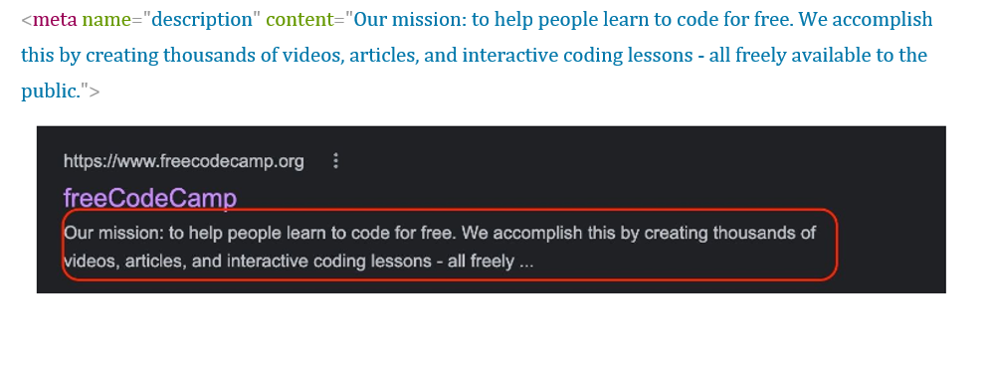

Slide 30
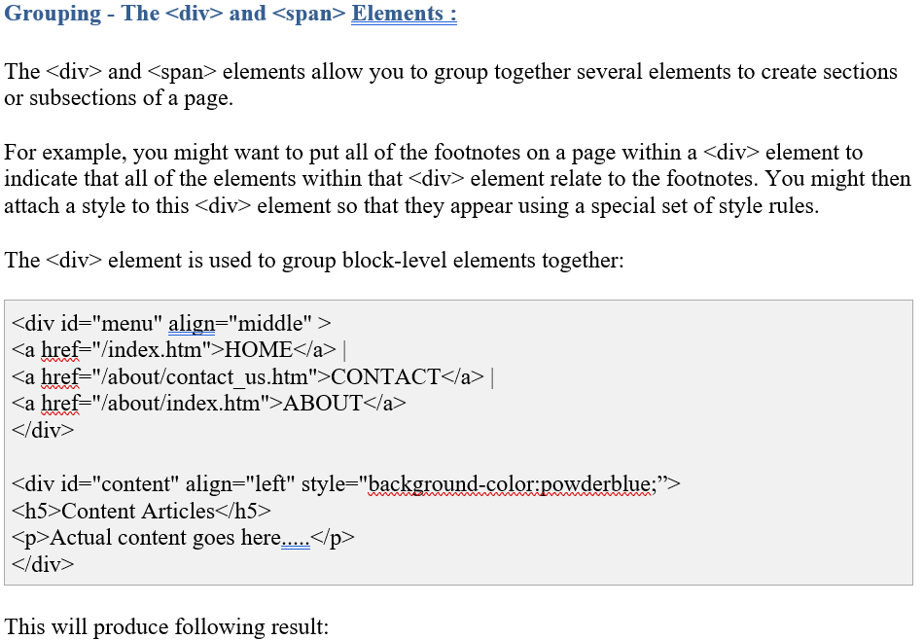

Slide 31
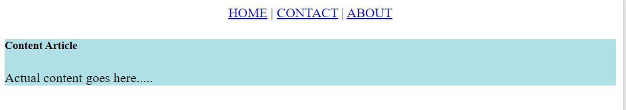
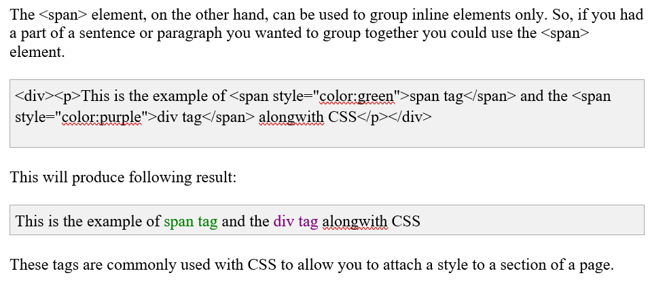

Slide 32
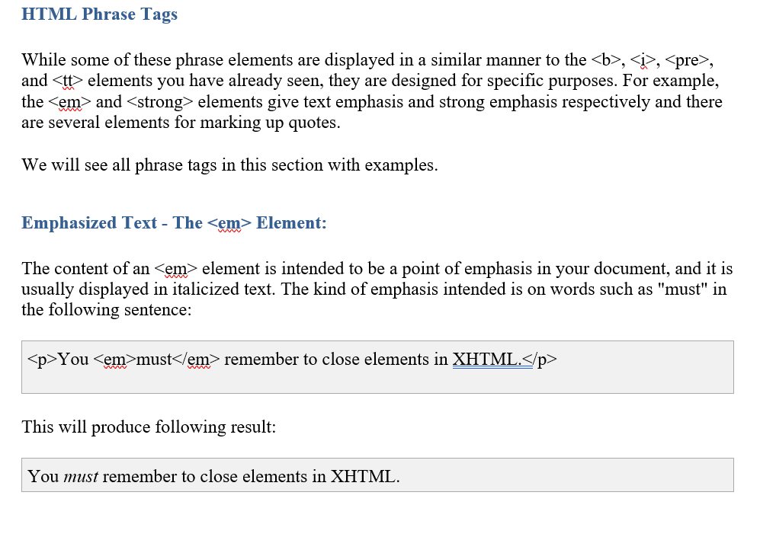

Slide 33
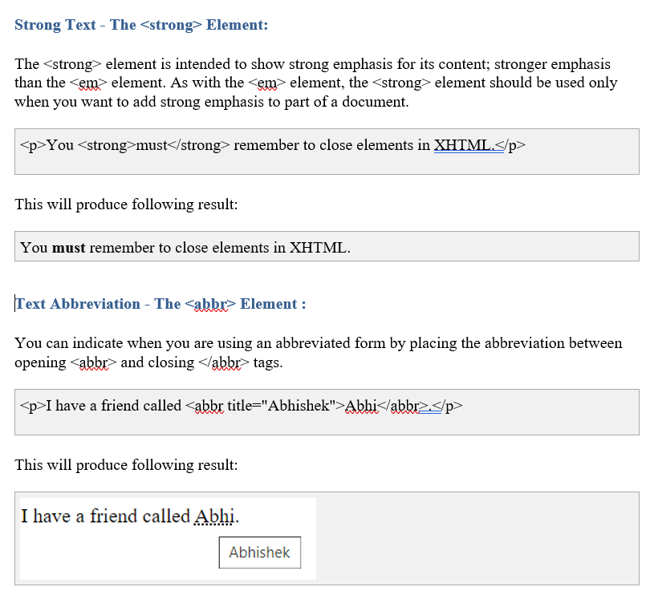

Slide 34
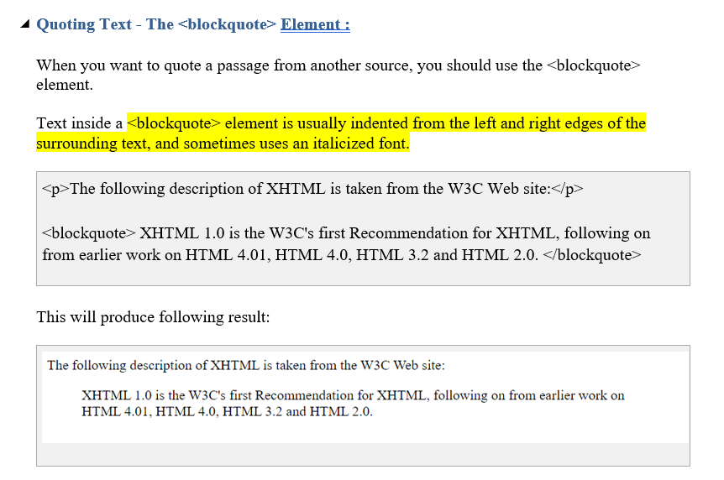

Slide 35
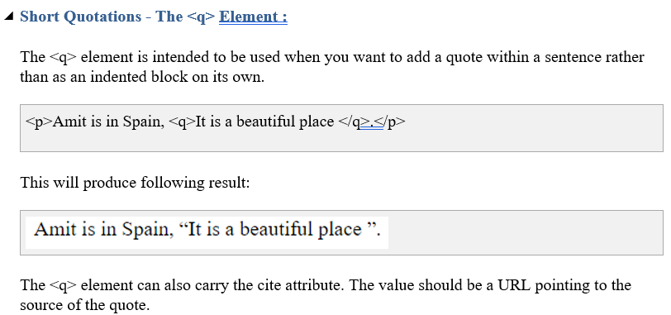

Slide 36
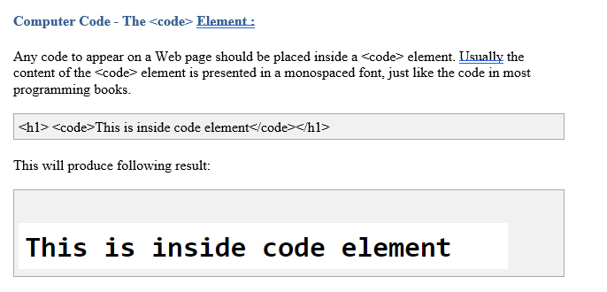

Slide 37
Block and Inline Elements:
We can categories all the elements into two sections:
Block-level elements - Block-level elements appear on the screen as if they have a carriage return or line break before and after them. For example the <p>, <h1>, <h2>, <h3>, <h4>, <h5>, <h6>, <ul>, <ol>, <dl>, <pre>, <hr />, <blockquote>and <div> elements are all block level elements. They all start on their own new line, and anything that follows them appears on its own new line.
Inline elements - Inline elements, on the other hand, can appear within sentences and do not have to appear on a new line of their own. The <b>, <i>, <u>, <em>, <strong>, <sup>, <sub>, <big>, <small>, <li> and <span> elements are all inline elements.

Slide 38
HTML Comments
HTML Comment lines are indicated by the special beginning tag <!-- and ending tag --> placed at the beginning and end of EVERY line to be treated as a comment.
For example: Given line is a valid comment in HTML
Multiline Comments:
<!-- This is commented out -->
<!-- This is a multiline comment <br /> and can span through as many as lines you like.-->

Slide 39
Commenting Scripts and Style Sheets:
<script> <!– document.write("Hello World!") //--> </script>
<style> <!— img{ border:0px; } //--> </style>

Slide 40
HTML marquee
A HTML marquee is a scrolling piece of text displayed either horizontally across or vertically down your web site page depending on the settings. This is created by using HTML tag <marquees>.

Slide 41
anchor tag or how to create links
The HTML anchor tag defines a hyperlink that links one page to another page. It can create hyperlink to other web page as well as files, location, or any URL. The "href" attribute is the most important attribute of the HTML a tag. and which links to destination page or URL.
href attribute of HTML anchor tag
The href attribute is used to define the address of the file to be linked. In other words, it points out the destination page.
The syntax of HTML anchor tag is given below:
<a href = "..........."> Link Text </a>
Eg: <a href="second.html">Click for Second Page</a>
Specify a location for Link using target attribute
If we want to open that link to another page then we can use target attribute of <a> tag. With the help of this link will be open in next page.
<p>Click on <a href="https://www.google.com/" target="_blank"> this-link </a>to go on home page .</p>

Slide 42
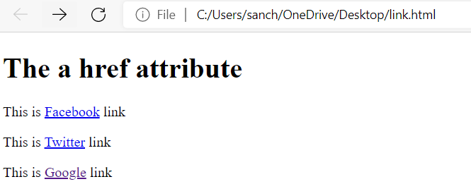
<body>
<h1>The a href attribute</h1>
<p>This is <a href="https://www.facebook.com">Facebook</a> link</p>
<p>This is <a href="https://www.twitter.com">Twitter</a> link</p>
<p>This is <a href="https://www.google.com">Google</a> link</p>
</body>
</html>

Slide 43
Important attributes of Anchor tag
target: specify where to display the contents of a selected hyperlink. If set to "_blank" then a new window will be opened to display the loaded page, if set to "_top" or "_parent" then same window will be used to display the loaded document, if set to "_self" then loads the new page in current window. By default its "_self".

Slide 44
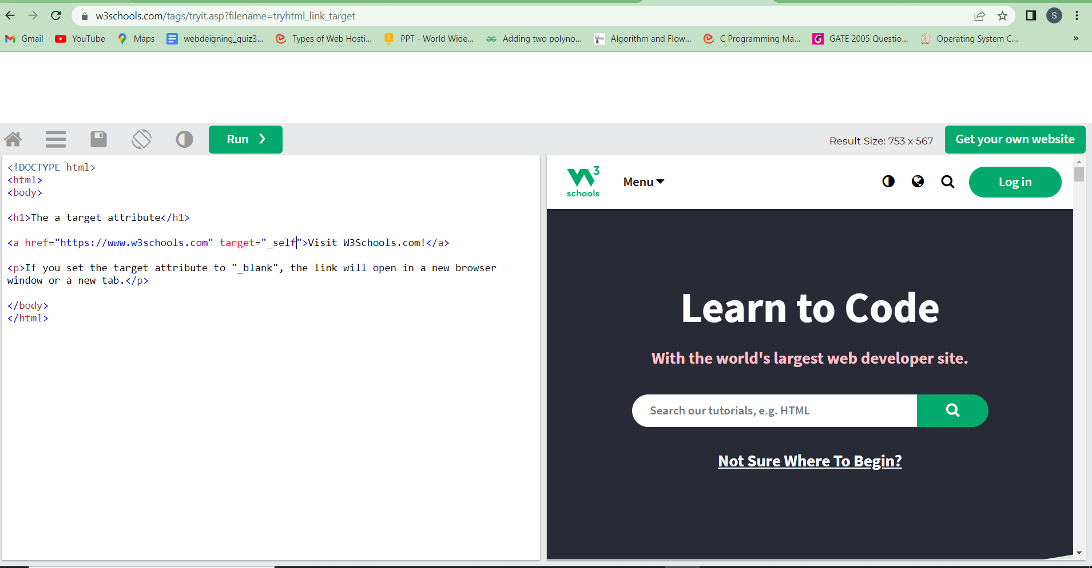

Slide 45
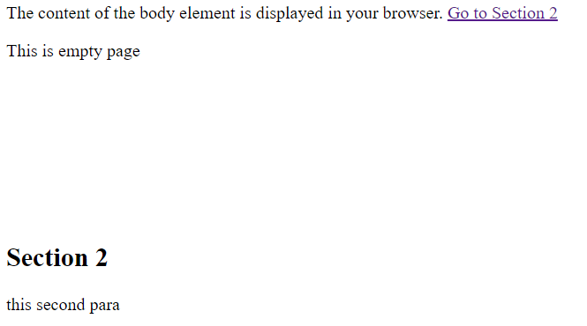
name & id: attributes places a label within a document. When that label is used in a link to that document, it is the equivalent of telling the browser to goto that label.
<a href="#section2">Go to Section 2</a>
<p>This is empty page
</p>
<h2 id="section2">Section 2</h2>
<p>this second para</p>

Slide 46
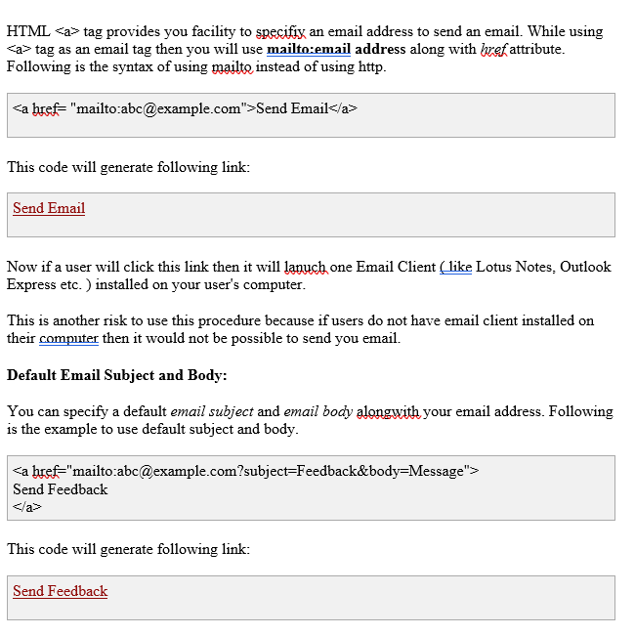
HTML Email Tag:

Slide 47
images
Images make up a key component of the web and come in a variety of format types (jpg, png, gif, and svg). The <img> tag is how we embed images into HTML documents:
The <img> element has two required attributes:
src provides the location (relative or absolute URL) of the image we want to reference.
alt provides an alternative text description of the referenced image for screen readers, search engines, etc.

Slide 48
<body>
<h1>adding image example</h1>
<h2>vertical-align: bottom</h2>
<p>This is some text. <img src="C:\Users\OneDrive\Documents\smilingface.gif" alt="Smiley face" width="42" height="42" style="vertical-align:bottom"> This is some text. This is some text. This is some text.</p>
<h2>vertical-align: middle</h2>
<p>This is some text. <img src="https://www.icegif.com/wp-content/uploads/flower-icegif-3.gif" alt="Smiley face" width="42" height="42" style="vertical-align:middle"> This is some text. This is some text. This is some text</p>
<h2>vertical-align: top</h2>
<p>This is some text. <img src="C:\Users\OneDrive\Documents\smilingface.gif" width="42" height="42" style="vertical-align:top"> This is some text. This is some text. This is some text.</p>
<h2>float: right</h2>
<p>This is some text.<img src="C:\Users\OneDrive\Documents\smilingface.gif" width="42" height="42" style="float:right">This is some text. This is some text. This is some text.</p>
<h2>float: left</h2>
<p>This is some text. <img src="C:\Users\OneDrive\Documents\smilingface.gif" width="42" height="42" style="float:left">This is some text. This is some text. This is some text.</p>
</body>

Slide 49
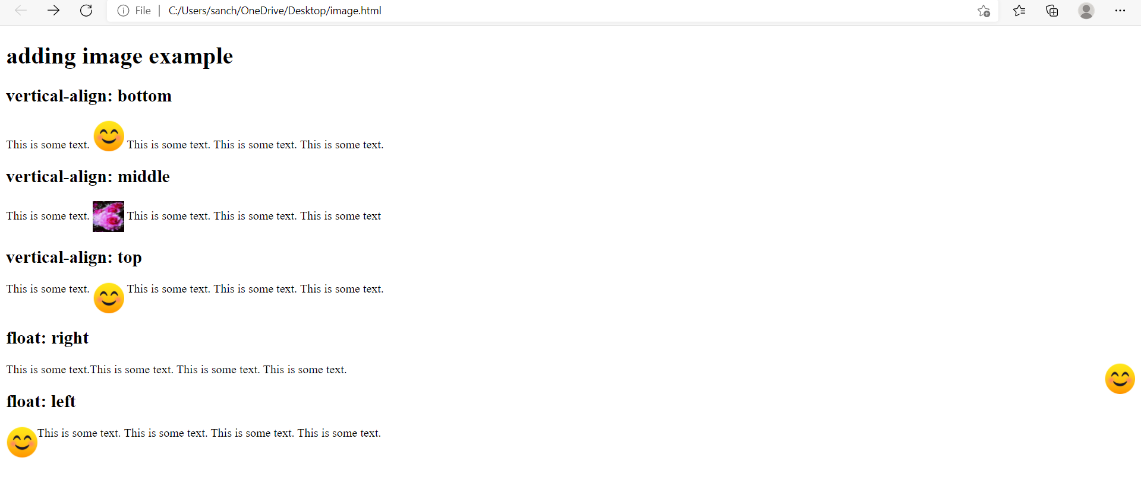

Slide 50
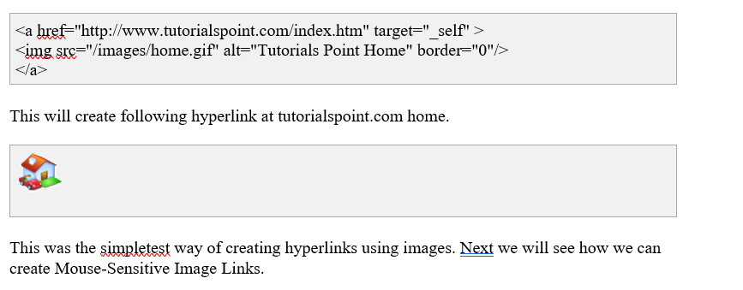
HTML Image Links

Slide 51
Image maps
Clicking different areas of the image causes the browser to link to different target documents. Such mouse-sensitive images known as image maps.
rect = x₁ , y₁ , x₂ , y₂
x₁ and y₁ are the coordinates of the upper left corner of the rectangle; x₂ and y₂ are the coordinates of the lower right corner
circle = x_{c} , y_{c} , radius
x_{c} and y_{c} are the coordinates of the center of the circle, and radius is the circle's radius.
poly = x₁ , y₁ , x₂ , y₂ , x₃ , y₃ , ... x_{n} , y_{n}

Slide 52
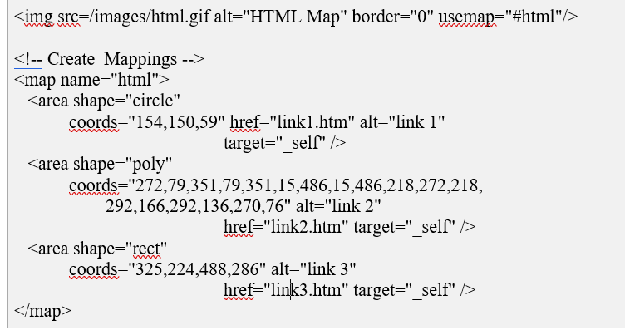
Image maps

Slide 53
